Slide 1


Aarthi. P
01 January 2026

Slide 2
Outline
Executive Summary
Introduction
Methodology
Results
Conclusion
Appendix
2

Slide 3
Executive Summary
Objective
Forecast the success of SpaceX Falcon 9 first-stage landings to assess launch cost efficiency and market competitiveness.
Methodology
Acquired launch data through the SpaceX REST API and web scraping techniques.
Conducted data cleaning, transformation, and exploratory analysis using SQL and visualizations.
Built interactive visual analytics dashboards using Folium and Plotly Dash.
Designed, trained, and evaluated multiple classification models.
Key Results
Higher flight numbers and optimized payload ranges were associated with increased landing success rates.
Specific orbits (such as SSO, GEO, and ES-L1) consistently demonstrated high success probabilities.
3

Slide 4
Introduction
SpaceX has revolutionized the commercial space industry by reusing Falcon 9 first-stage boosters, significantly reducing launch costs. | The success or failure of a booster landing directly affects mission cost, operational efficiency, and launch competitiveness.
Historical Falcon 9 launch data provides insights into how factors such as payload mass, orbit type, and flight number affect landing success. | This project analyzes these factors and develops a classification model to predict Falcon 9 first-stage landing success.
4

Slide 5

Section 1
5

Slide 6
Methodology
Falcon 9 launch data was collected from multiple public sources and consolidated into a single analytical dataset.
Interactive visual analytics were developed to examine geographic and operational factors.
Data was cleaned, processed, and explored to identify patterns influencing first-stage landing success.
Predictive classification models were built, tuned, and evaluated to estimate landing success probability.

Slide 7

Data Collection
Launch, rocket, payload, and landing data were retrieved using the SpaceX REST API.
Multiple API endpoints were queried to obtain mission details, booster versions, orbit types, and outcomes.
API responses were parsed and stored as structured Pandas DataFrames for downstream analysis.

Slide 8
Data Collection - Scraping
1
2
3
4
5
6
7
8
9
Import libraries such as requests a nd Beautiful Soup to perform web requests and parse HTML content.
Make a GET request to the target website URL to retrieve the raw HTML page source.
Parse the
HTML
content with BeautifulSou p to build a structured parse tree for easy navigation.
Identify and locate the specific HTML
elements that contain the data you want to scrape (e.g., tables or divs).
Iterate through these elements to extract the relevant text or attribute data systematicall y.
Clean and preprocess the extracted data by removing unwanted characters and formatting inconsistenci es.
Organize the cleaned data into lists or dictionaries to prepare for analysis.
Convert the organized data into a Pandas DataFrame within JupyterLab for further manipulatio n and visualization.
Validate the scraped data to ensure accuracy and completenes s before proceeding with analysis or modeling.
9

Slide 9
Data Wrangling
Import necessary libraries such as pandas, numpy,
and requests for data manipulation and API requests.
Make a GET request to the SapaceX API to retrieve raw launch data in JSON format.
Use json_normalize or similar methods to convert nested JSON data into a flat Pandas DataFrame.
Inspect and clean the
DataFrame by handling missing values, correcting data types, and renaming columns for clarity.
Extract and transform specific columns such as booster version, payload mass, launch site, and core details.
Create new columns or features as needed to better represent or summarize the data.
Filter or subset the DataFrame to focus on relevant launches or data points for analysis.
Use JupyterLab cells to iteratively test and refine your data wrangling code for accuracy.
Document your data
cleaning and transformation process with comments and markdown cells for clarity.
10

Slide 10
EDA with SQL
Retrieve unique launch sites:
Display the distinct names of all launch sites involved in the space missions.
Filter launch sites starting with 'CCA':
Select 5 records where the launch site names begin with the string 'CCA'.
Identify booster versions with maximum payload mass:
Use a subquery with an aggregate function to find booster versions that carried the
maximum payload.
List failure landing outcomes for 2015:
Extract records showing failure landing outcomes on drone ships, booster versions, and
launch sites for each month in 2015 using substring functions to parse dates.
Rank landing outcomes between specific dates:
Count and rank landing outcomes (e.g., Failure (drone ship), Success (ground pad)) between 2010-06-04 and 2017-03-20 in descending order.
11

Slide 11
EDA with Data Visualization
Scatter Point Charts
Flight Number vs Launch Site: To visualize how flight numbers are distributed across launch sites and their success/failure outcomes.
Flight Number vs Orbit: To explore the distribution of flights by orbit type and success class.
Payload Mass vs Launch Site: To examine how payload mass varies with different launch sites and success outcomes.
Payload Mass vs Orbit: To see the relationship between payload mass and orbit types, along with success classification.
Line Chart
Year vs Average Success Rate: To observe trends in launch success rates over time.
12

Slide 12
Build an Interactive Map with Folium
Map Objects Added to My Folium Map
Markers: I added markers to highlight specific points of interest, such as launch sites and launch results. These helped me visually identify exact locations and included labels to show additional information like success/failure status or distance.
Circles: I added circles around launch sites to emphasize their area and provide a sense of scale. Each
circle included a popup with the site name.
Lines (PolyLine): I used lines to connect coordinates, for example between a launch site and the closest coastline, to visualize spatial relationships and distances.
Marker Clusters: I grouped nearby markers using clustering to reduce clutter and improve map
readability, especially when displaying many launch results.
Divicon Markers: I added custom text labels directly on the map, such as distance measurements, using DivIcon markers.
Purpose: These objects enhanced the map’s visualization, making it easier to understand spatial distributions, relationships, and key details of SpaceX launch sites and mission results.
13

Slide 13
Build a Dashboard with Plotly Dash
Plots and Graphs in My Plotly Dash Dashboard
Pie Chart: Shows the proportion of successful vs. failed launches, helping me quickly visualize overall launch success rates.
Scatter Plot: Displays launch outcomes, e.g., payload mass vs. launch site or booster version, helping identify patterns or correlations.
Bar Chart: Compares success counts or rates across launch sites or other categorical variables.
Histogram/Box Plot: Shows distributions of payload mass or other numeric variables for deeper insight.
Interactive Components Added:
Dropdown Menus: Let users select launch sites or booster versions to dynamically filter data.
Range Sliders: Filter data by payload mass or date range to explore subsets of launches.
14

Slide 14
Build a Dashboard with Plotly Dash
Purpose and Benefits of the Dashboard:
Hover Tooltips: Provide detailed information on data points for better insight.
Callbacks: Connect user inputs (dropdowns, sliders) to update plots dynamically, making the dashboard interactive and responsive.
The benefits of Plots and Interactions:
To explore relationships between launch parameters and success outcomes interactively.
To enable filtering and drilling down into specific launch sites, payload ranges, or booster versions.
To visualize distributions and proportions clearly and intuitively.
To provide an engaging experience where users can manipulate inputs and immediately see
results, reinforcing insights from the SpaceX dataset.
15

Slide 15
Predictive Analysis (Classification)
Building and Evaluating Classification Models
Data Preparation:
Load and preprocess dataset (handle missing values, encode categorical variables, scale features)
Split data into training and testing sets
Model Building:
Select classification algorithms (Logistic Regression, Decision Tree, Random Forest, SVM)
Train models on training data
Model Evaluation:
Predict on test data and evaluate using accuracy, precision, recall, F1-score, and confusion matrix Use cross-validation to check model stability
Model Improvement:
Tune hyperparameters (Grid Search, Randomized Search)
Apply feature engineering or feature selection
16

Slide 16
Predictive Analysis (Classification)
How the Best Model Was Chosen:
Compared multiple models using validation metrics (accuracy, precision, recall, F1-score).
Prioritized models with balanced performance,
not just highest accuracy.
Used cross-validation results to ensure consistent performance and avoid overfitting.
Selected the model that showed strong
generalization across unseen data.
Final Validation:
Evaluated the selected model on the test set to confirm real-world performance.
Data Preparation
Model Selection & Training
Model Evaluation
Hyperparameter Tuning
Feature Engineering / Selection
Re-evaluate Models
Select Best Performing Model
Final Validation
17

Slide 17
Results
Exploratory Data Analysis (EDA) Results
Launch Site Insights:
Visualized SpaceX launch sites on interactive Folium maps.
Identified geographic distribution and clusters of launch sites.
Explored success rates by launch site, revealing some sites have higher success probabilities.
Analyzed distances from launch sites to nearby coastlines and potential impacts.
Payload and Booster Analysis:
Examined payload mass distributions and their relation to launch success.
Investigated booster version categories and their influence on launch outcomes.
Used scatter plots and pie charts to visualize payload vs. success and booster performance.
Temporal Trends:
Analyzed launch success trends over time.
Identified patterns or anomalies in launch outcomes across different periods.

Slide 18
Results
Predictive Analysis Results
Model Development:
Built multiple classification models (Logistic Regression, Decision Tree, Random Forest) to predict launch success.
Used training and testing splits to validate model performance.
Evaluation Metrics:
Assessed models using accuracy, precision, recall, F1-score, and confusion matrices.
Applied cross-validation to ensure model robustness.
Model Improvement & Best Model Selection:
Performed hyperparameter tuning (Grid Search/Randomized Search) to optimize models.
Applied feature engineering and selection to enhance predictive power.
Selected the model with the highest predictive accuracy and balanced metrics.
Validated the final model on test data to confirm generalization.

Slide 19

Section 2

Slide 20
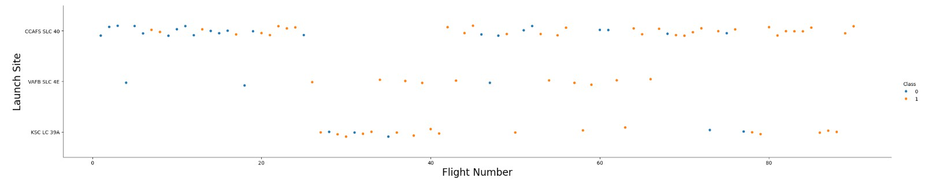
Flight Number vs. Launch Site
The early launches were mostly met with fail for both CCAFS SLC 40 & VAFB
SLC 4E, however, the success rate improved with each flight.
KSC LC 39A shows no clear pattern but marginally higher success rates than the rest.
The most recent launches of all the three have mostly been successful.

Slide 21
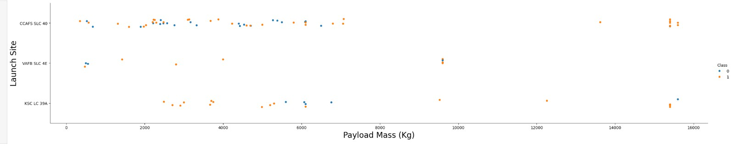
Payload vs. Launch Site
All the three launch sites have see a much higher success rates at heavier payload
masses.
The greatest number of launches have been done at a payload mass of 8000kg or less.
CCAFS SLC 40 sees a fluctuation in the number of successes while VAFB SLC 4E and KSC LC 39A mostly have all success through the entire range of payload masses.

Slide 22
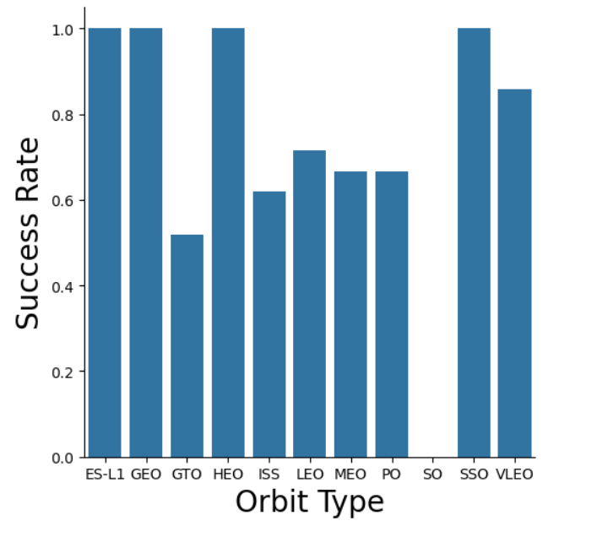
Success Rate vs. Orbit Type
ES-L1, GEO, HEO and SSO
have 100% success rates
VLEO is also pretty
successful at around 85%.
GTO, ISS, LEO, MEO AND PO
all have medium success rates at around 50% on average.
SO has 0% success rate so far, perhaps an anomaly.

Slide 23
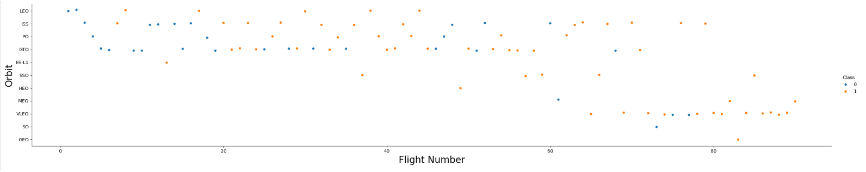
Flight Number vs. Orbit Type
As the flight number increases the success rate also increases for most orbit types except the ones with less launches.

Slide 24
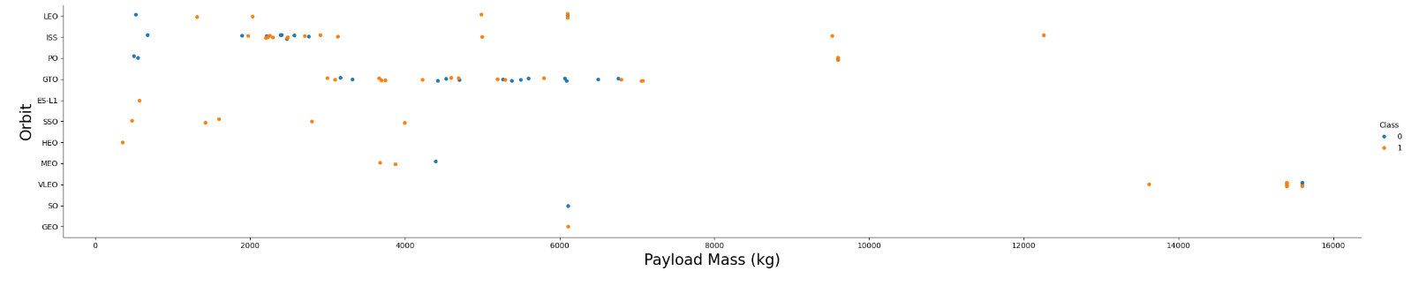
Payload vs. Orbit Type
Higher payload masses have much higher success rate
Early instances have often resulted in failures for launch sites LEO, ISS, and PO

Slide 25
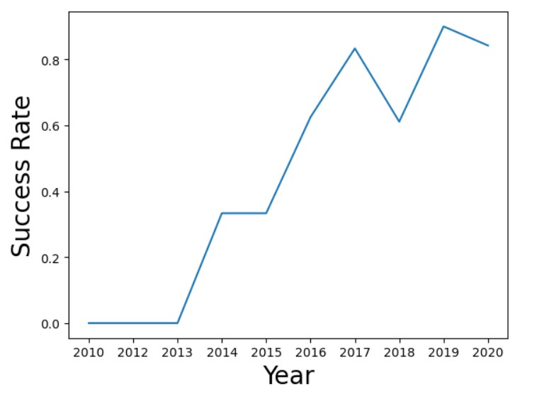
Launch Success Yearly Trend
No successes until 2014
Sees an overall rise after
2014.
2013-2017 sees the highest increase in rate
The success rate starts fluctuating post 2017

Slide 26
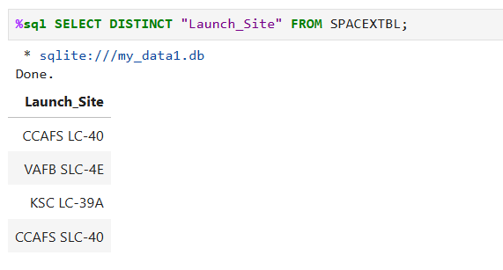
All Launch Site Names

Slide 27
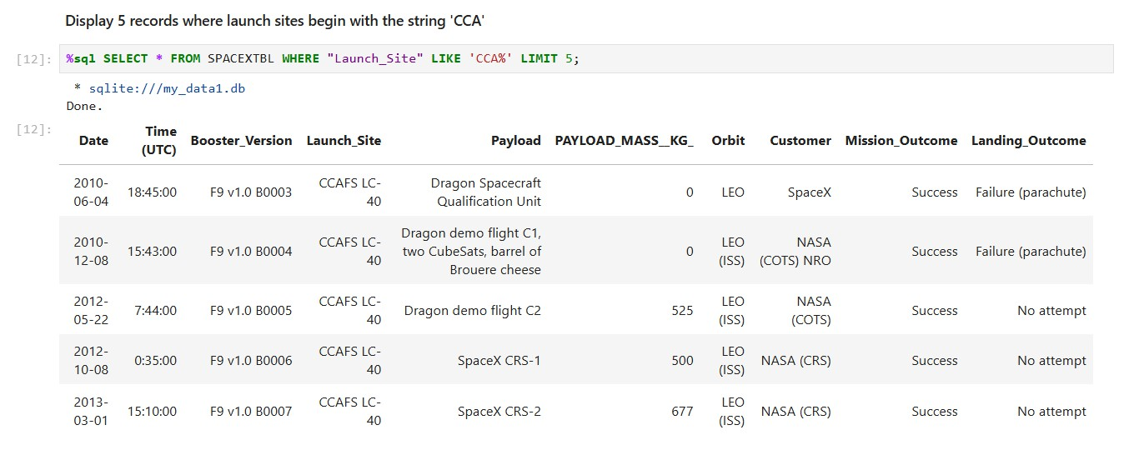
Launch Site Names Begin with 'CCA'
All landing attempts either failed either or hadn’t been attempted. While all the mission had a
successful launch.

Slide 28
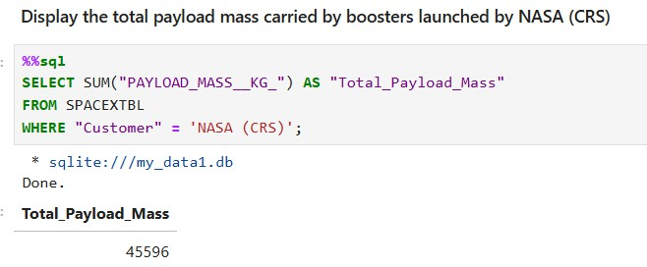
Total Payload Mass

Slide 29
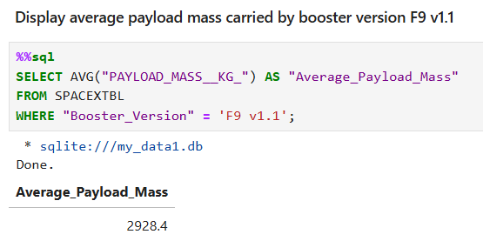
Average Payload Mass by F9 v1.1

Slide 30
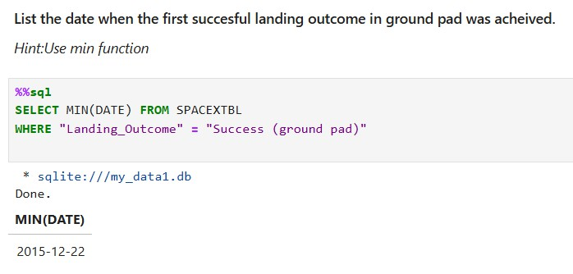
First Successful Ground Landing Date

Slide 31
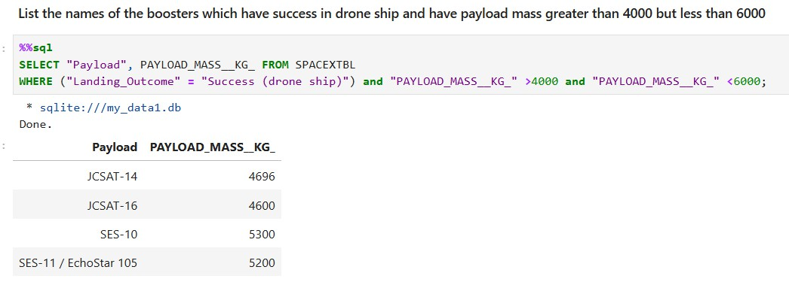
Successful Drone Ship Landing with Payload between 4000 and 6000

Slide 32
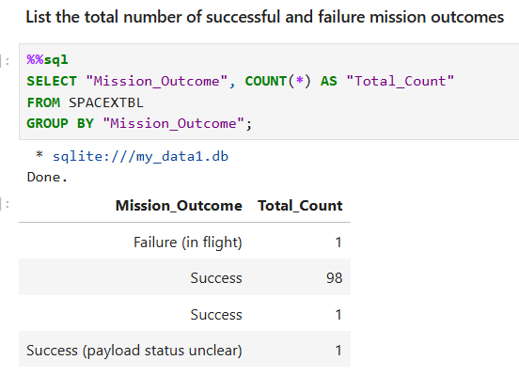
Total Number of Successful and Failure Mission Outcomes

Slide 33
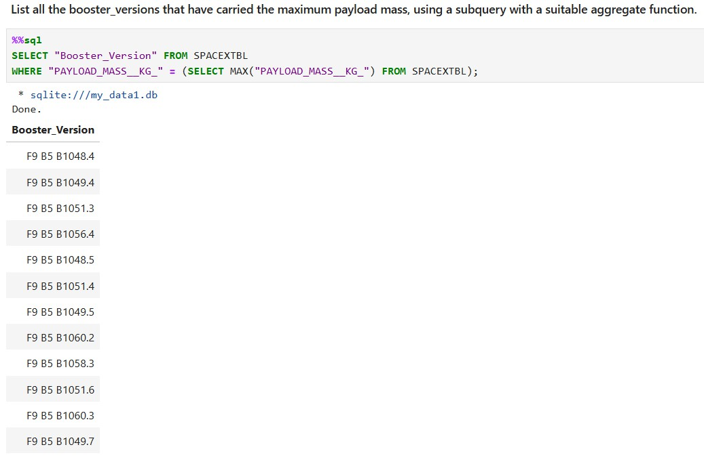
Boosters Carried Maximum Payload

Slide 34
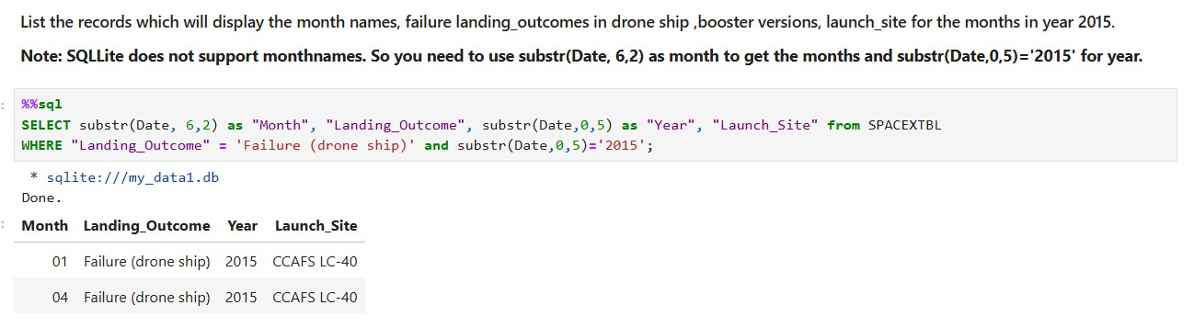
2015 Launch Records

Slide 35
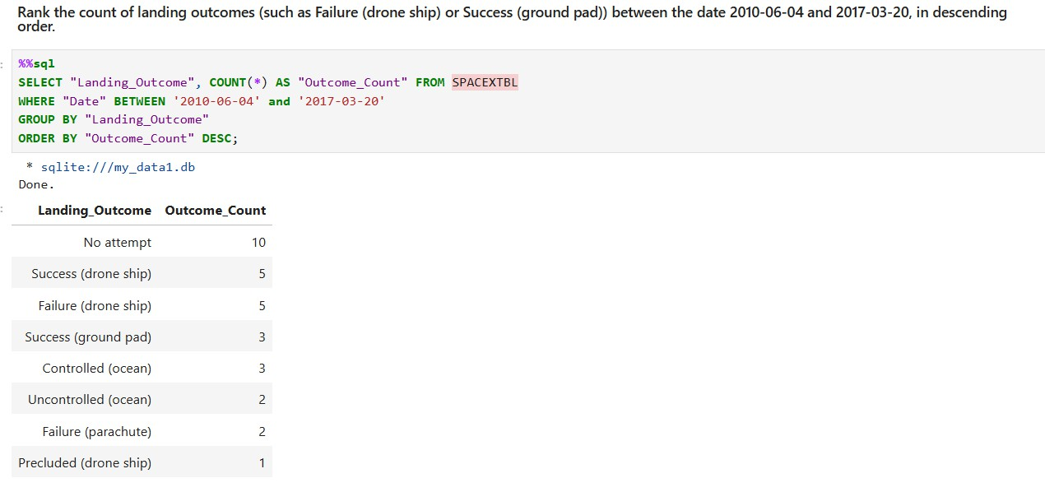
Rank Landing Outcomes Between 2010-06-04 and 2017-03-20

Slide 36

Section 3

Slide 37
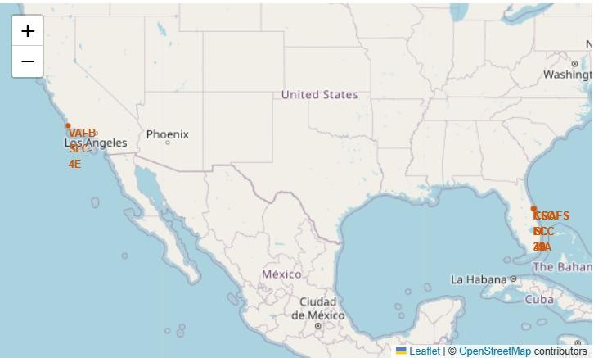
Launch Site Locations on an interative map
Key Features
Launch Site Circles (folium.Circle): Added circles around each launch site coordinate to highlight their locations with a visible radius and popup labels showing the site names.
Launch Site Markers (folium.Marker): Placed markers at each launch site coordinate to pinpoint exact locations on the map.
These features help visually identify and emphasize the important launch sites on the interactive map, providing a clear spatial context for further analysis.

Slide 38
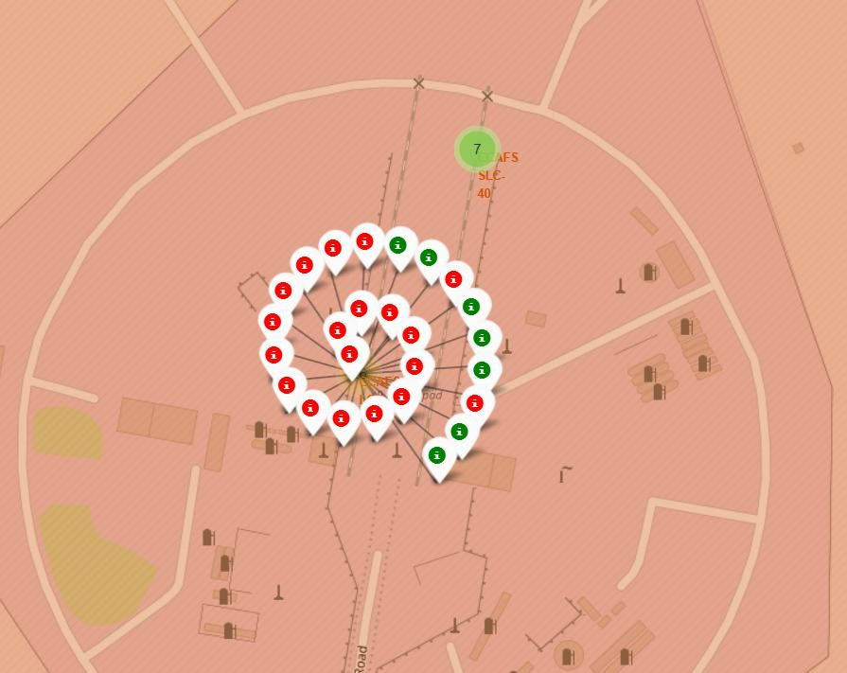
Color Labeled Individual Launch Sites
Folium Map Features
Marker Clusters: Grouped nearby launch markers to reduce clutter and improve map readability when displaying many launches.
Launch Result Markers: Added individual markers for each launch, with visual indicators showing success or failure.
Dynamic Marker Icons: Used different marker colors/icons to clearly distinguish successful and failed launches.
These features make the map more interactive,
readable, and effective for analyzing launch outcomes.

Slide 39
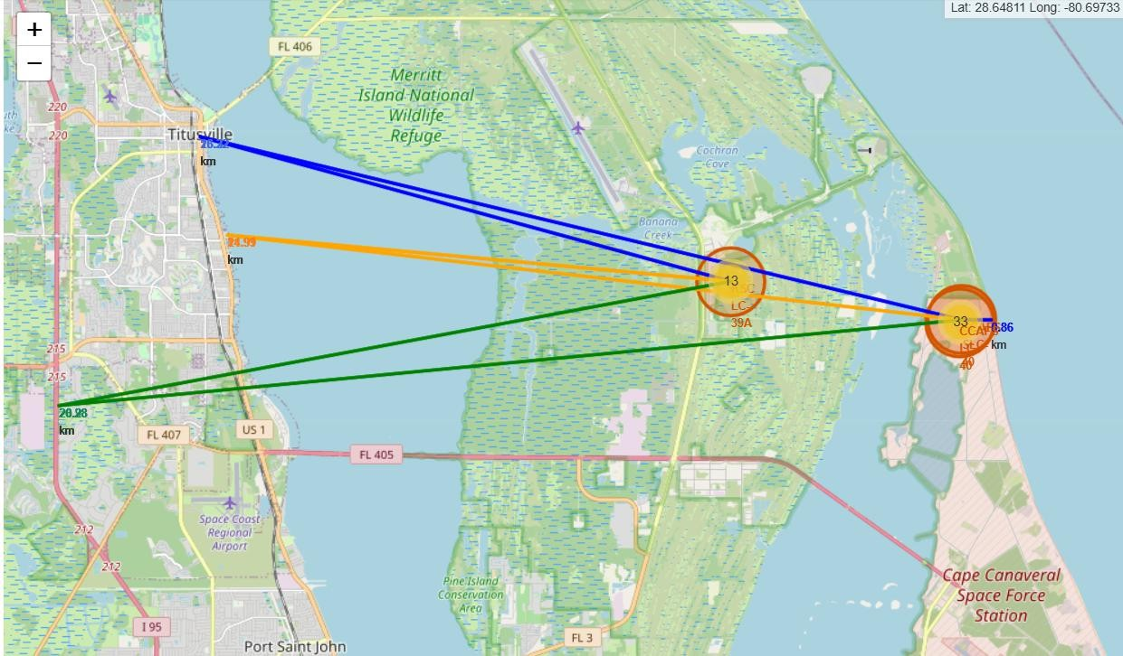
Proximity to nearby cities and transport
Distance and Spatial Annotations
Distance Markers (DivIcon): Added custom markers showing the distance between each launch site and its nearest coastline.
Connecting Lines (PolyLine): Drew lines from launch sites to coastlines to visualize spatial relationships.
Enhanced Visual Annotations: Combined launch site markers, coastline points, and distance labels for clear geographic context.

Slide 40

Section 4

Slide 41
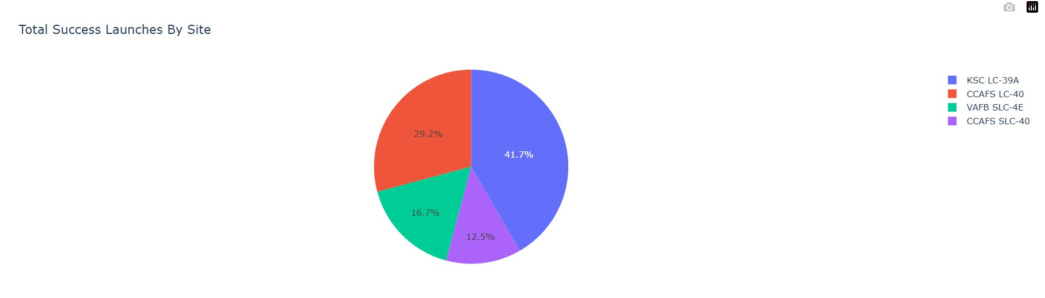
Total Successful Launches for each Launch Site
This chart show the distribution of all the successful launches by each site, KSC LC 39A contributes the most to this while CCAFS SLC 40 contributes the least.

Slide 42
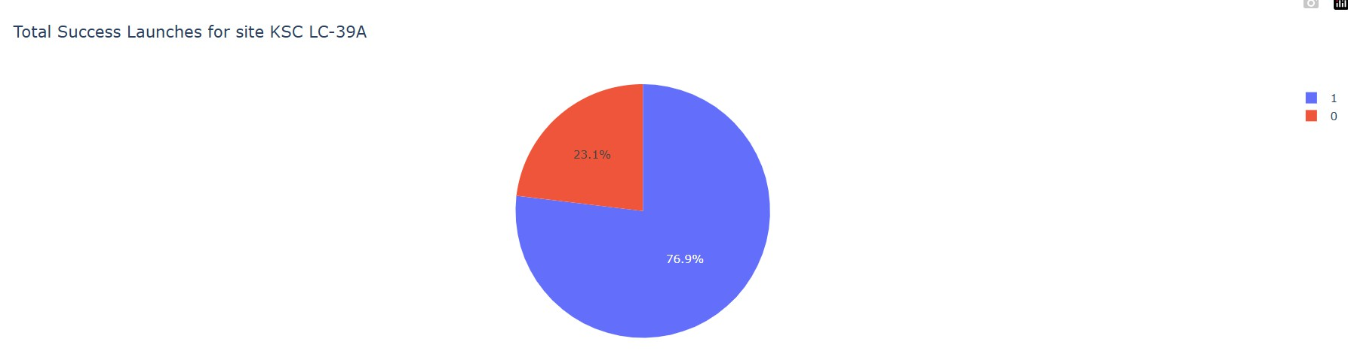
Launch Site with the Highest Success Ratio
KSC LC 39A has the highest ratio of successful launches, with just over
¾ of its launches being successful.

Slide 43
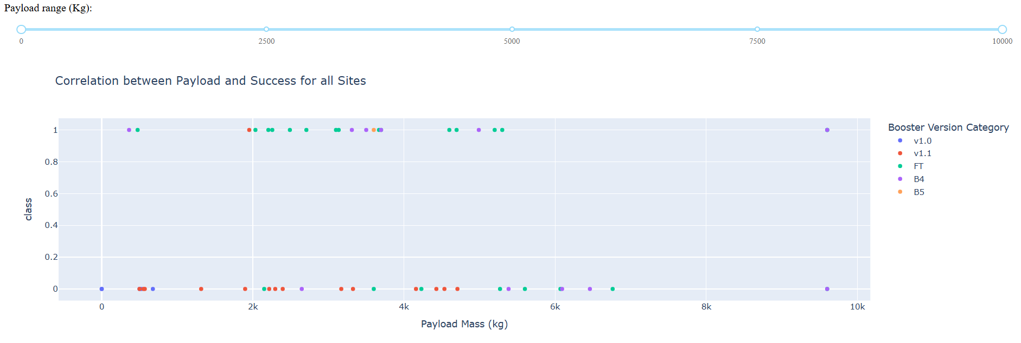
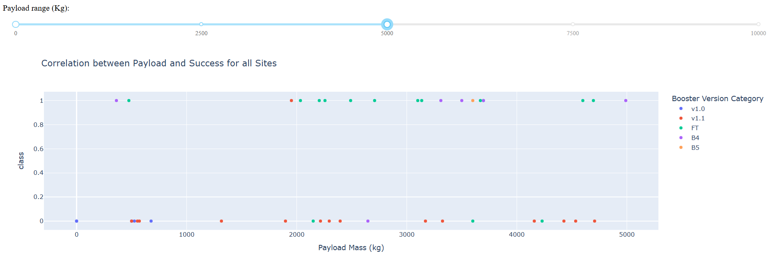
Launch Success vs. Payload Mass
The success rate is highest at lower payload masses
Most of the launches made by all the sites are between 0 to 5000 KGs

Slide 44

Section 5

Slide 45
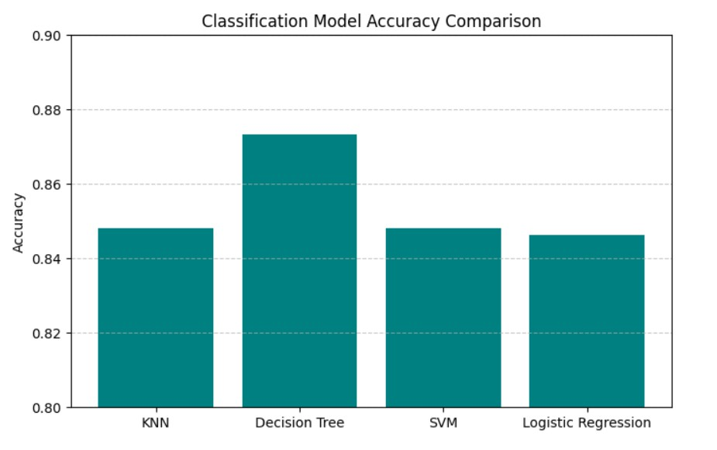
Classification Accuracy
This bar graph shows the classification model accuracy for the different machine learning models. This includes the optimization after using gridsearch.
Decision Tree has the highest accuracy out of all the machine learning models.

Slide 46
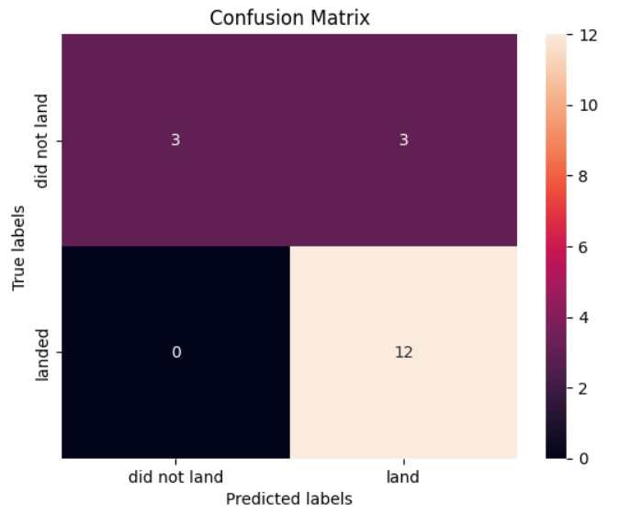
Confusion Matrix for Decision Trees Model
True Positives (land correctly predicted): 12
True Negatives (did not land correctly predicted): 3
False Positives (predicted land
but did not land): 3
False Negatives (predicted did not land but landed): 0

Slide 47
Conclusions
Landing success is predictable: Falcon 9 first-stage landing outcomes can be predicted with good reliability using historical launch data, showing that success depends on measurable mission parameters.
Best-performing model identified: The Decision Tree classifier achieved the highest test accuracy (~83%), outperforming Logistic Regression, SVM, and KNN by capturing non-linear feature interactions.
Key factors influencing success:
Higher flight numbers correlate with improved success rates, reflecting technological maturity.
Payload mass shows a positive relationship with success up to an optimal threshold.
Certain orbits (ES-L1, GEO, HEO, SSO) achieved near-perfect success rates.
48

Slide 48
Conclusions
Launch site strategy supports reliability: Coastal launch sites located away from population centers enhance safety and recovery efficiency, contributing to higher landing success.
Actionable decision support:The predictive model, Folium maps, and Dash dashboards enable cost estimation and strategic analysis for competitors bidding against SpaceX.
Limitations: Model performance is constrained by available features and historical data size.
Future work: Incorporating weather conditions, booster reuse count, and advanced ensemble models could further improve prediction accuracy.

Slide 49
Appendix
Coursera – IBM Data Science Capstone ProjectProject framework, instructions, and evaluation criteria
SpaceX Launch DataPublicly available data accessed via the SpaceX REST API
Wikipedia - General background information on Falcon 9, launch sites, and orbital classifications
Github Link– All notebooks that have been used in this project has been added to the Github Repository

Slide 50


